Slide 1
CORTEX MO TECHNICAL OVERVIEW
The Cortex-M0 processor is a 32-bit Reduced Instruction Set Computing (RISC) processor with a von Neumann architecture (single bus interface).
It uses an instruction set called Thumb, which was ﬁrst supported in the ARM7TDMI processor; however, several newer instructions from the ARMv6 architecture and a few instructions from the Thumb-2 technology are also included.
Thumb-2 technology extended the previous Thumb instruction set to allow all operations to be carried out in one CPU state.
The instruction set in Thumb-2 included both 16-bit and 32-bit instructions;
most instructions generated by the C compiler use the 16-bit instructions, and the 32-bit instructions are used when the 16-bit version cannot carry out the required operations.
This results in high code density and avoids the overhead of switching between two instruction sets.
In total, the Cortex-M0 processor supports only 56 base instructions, although some instructions can have more than one form. Although the instruction set is small, the Cortex- M0 processor is highly capable because the Thumb instruction set is highly optimized.
Academically, the Cortex-M0 processor is classiﬁed as load-store architecture

Slide 2
Introduction to Cortex-M0 Programming Introduction to Embedded System
Most modern microcontrollers have on-chip ﬂash memory to hold the compiled program. The ﬂash memory holds the program in binary machine code format, and therefore programs written in C must be compiled before programmed to the ﬂash memory.
Some of these microcontrollers might also have a separate boot ROM, which contains a small boot loader program that is executed when the microcontroller starts, before executing the user program in the ﬂash memory.
In most cases, only the program code in the ﬂash memory can be changed and the boot loader is ﬁxed. After the ﬂash memory (or other types of program memory) is programmed, the program is then accessible by the processor.
After the processor is reset, it carries out the reset sequence, as

Slide 3
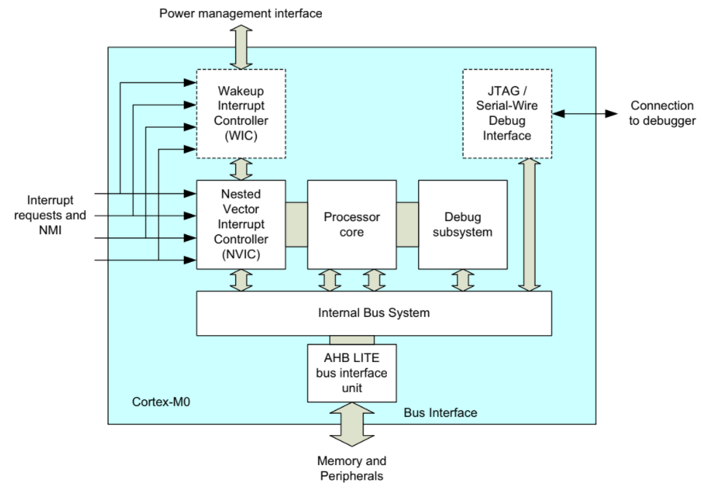
Simplified Block Diagram of Cortex M0

Slide 4
Continued….
The processor core contains the register banks, ALU, data path, and control logic.
It is a three- stage pipeline design with fetch stage, decode stage, and execution stage.
The register bank has sixteen 32-bit registers. A few registers have special usages.
The Nested Vectored Interrupt Controller (NVIC) accepts up to 32 interrupt request signals and a nonmaskable interrupt (NMI) input.
It contains the functionality required for comparing priority between interrupt requests and the current priority level so that nested interrupts can be handled automatically.
If an interrupt is accepted, it communicates with the processor so that the processor can execute the correct interrupt handler.

Slide 5
Continue…
When an interrupt request is detected,the WIC informs the power management
to power up the system so that the NVIC and the processor core can then
handle the rest of the interrupt processing.
The debug subsystem contains Various functional blocks to handle
debug control, program breakpoints, and data watchpoints.
When a debug event occurs, it can put the processor core in a halted state
so that embedded developers can examine the status of the processor at that point.
The JTAG or serial wire interface units provide access to the bus system and debugging functionalities.
The JTAG protocol is a popular ﬁve-pin communication protocol commonly
used for testing.
The serial wire protocol is a newer communication protocol that only requires two wires, but it can handle the same debug functionalities as JTAG.
The internal bus system, the data path in the processor core, and the AHB LITE bus interface are all 32 bits wide.

Slide 6
The Wakeup Interrupt Controller (WIC) is an optional unit. In low-power applications, the microcontroller can enter standby state with most of the processor powered down. In this situation, the WIC can perform the function of interrupt masking while the NVIC and the processor core are inactive.
AHB-Lite is an on-chip bus protocol used in many ARM processors.
This bus protocol is part of the Advanced Microcontroller Bus Architecture (AMBA) speciﬁcation, a bus architecture developed by ARM that is widely used in the IC design industry.

Slide 7
processor core are inactive. When an interrupt request is detected, the WIC informs the power
management to power up the system so that the NVIC and the processor core can then handle
the rest of the interrupt processing.
The debug subsystem contains various functional blocks to handle debug control, program
breakpoints, and data watchpoints. When a debug event occurs, it can put the processor core in
a halted state so that embedded developers can examine the status of the processor at that point.

Slide 8
The JTAG or serial wire interface units provide access to the bus system and debugging functionalities.
The JTAG protocol is a popular five-pin communication protocol commonly used for testing.
The serial wire protocol is a newer communication protocol that only requires two wires, but it can handle the same debug functionalities as JTAG.
The internal bus system, the data path in the processor core, and the AHB LITE bus interface are all 32 bits wide. AHB-Lite(advanced High Performance Bus) is an on-chip bus protocol used in many ARM processors.
This bus protocol is part of the Advanced Microcontroller Bus Architecture (AMBA) specification, a bus architecture developed by ARM that is wide

Slide 9
interrupt handler is executed automatically without the need to determine the exception
vector in software.
• Interrupts can have four different programmable priority levels. The NVIC automatically
handles nested interrupts.
• Deterministic exception response timing. The design can be set up to respond
to exceptions (e.g., interrupts) with a fixed number of cycles (constant interrupt
latency arrangement) or to respond to the exception as soon as possible (minimum
16 clock cycles).

Slide 10
Nonmaskable interrupt (NMI) input for safety critical systems.
Architectural predefined memory map. The memory space of the Cortex-M0 processor

Slide 11
System Features
Thumb instruction set. Highly efficient, high code density and able to execute all Thumb Instructions from the ARM7TDMI processor.
High performance. Up to 0.9 DMIPS/MHz (Dhrystone 2.1million instructions per second/MHZ) with fast multiplier or 0.85 DMIPS/MHz with smaller multiplier.
Built-in Nested Vectored Interrupt Controller (NVIC). This makes interrupt configuration and coding of exception handlers easy.
When an interrupt request is taken, the corresponding is architecturally predefined to make software porting easier and to allow easier optimization of chip design.
However, the arrangement is very flexible. The memory space is linear and there is no memory paging required like in a number of other processor architectures.

Slide 12
Easy to use and C friendly. There are only two modes (Thread mode and Handler mode).
The whole application, including exception handlers, can be written in C without any assembler.
Built-in optional System Tick timer for OS support. A 24-bit timer with a dedicated exception type is included in the architecture, which the OS can use as a tick timer or as a general timer in other applications without an OS.
SuperVisor Call (SVC) instruction with a dedicated SVC exception and PendSV (Pendable Supervisor service) to support various operations in an embedded OS.
Architecturally defined sleep modes and instructions to enter sleep. The sleep features allow power consumption to be reduced dramatically.

Slide 13
Continued…
Defining sleep modes as an architectural feature makes porting of software easier because sleep is entered by a specific instruction rather than implementation defined control registers.
Fault handling exception to catch various sources of errors in the system.

Slide 14
Implementation Features
Configurable number of interrupts (1 to 32)
Fast multiplier (single cycle) or small multiplier (for a smaller chip area and lower power,32 cycles)
Little endian or big endian memory support
Optional Wakeup Interrupt Controller (WIC) to allow the processor to be powered down during sleep, while still allowing interrupt sources to wake up the system
Very low gate count, which allows the design to be implemented in mixed signal
semiconductor processes

Slide 15
Debug Features
• Halt mode debug. Allows the processor activity to stop completely so that register values can be accessed and modified. No overhead in code size and stack memory size.
CoreSight technology. Allows memories and peripherals to be accessed from the debugger without halting the processor. It also allows a system-on-chip design with multiple processors to share a single debug connection.
Supports JTAG connection and serial wire debug connections. The serial wire debug protocol can handle the same debug features as the JTAG, but it only requires two wires and is already supported by a number of debug solutions from various tools vendors.

Slide 16
Configurable number of hardware breakpoints (from 0 to maximum of 4) and watchpoints (from 0 to maximum of 2). The chip manufacturer defines this during implementation.
Breakpoint instruction support for an unlimited number of software breakpoints.
All debug features can be omitted by chip vendors to allow minimum size implementations.

Slide 17
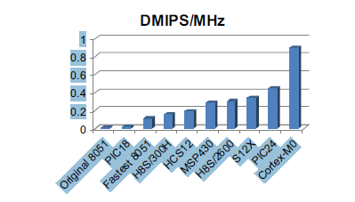
Advantages of the Cortex-M0 Processor
Energy Efficiency:The Cortex-M0 processor is about the same size as a typical 16-bit processor and possibly several times bigger than some of the 8-bit processors.
However, it has much better performance than 16-bit and 8-bit architectures

Slide 18
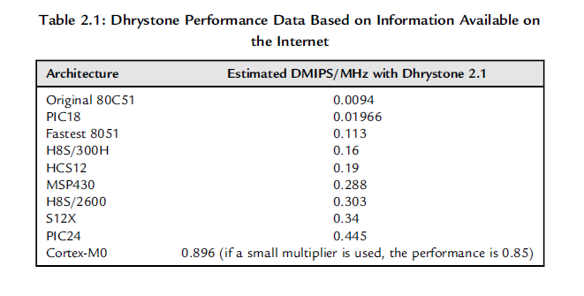
Performance of Cortex M0 in Terms of DMIPS/MHz

Slide 19
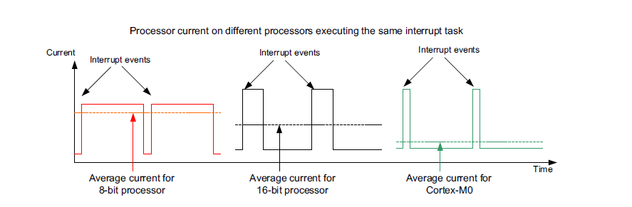
Average Current for different processors

Slide 20
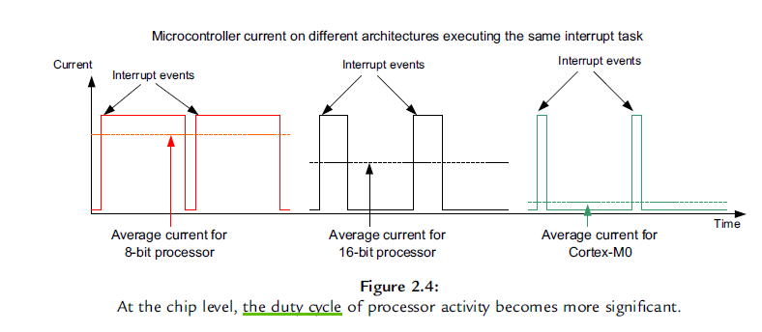
Microcontroller Current on different Architectures executing the same interrupt task

Slide 21
Limitations in 8-Bit and 16-Bit Architectures
Another important reason to use the 32-bit Cortex-M0 processor rather than the traditional 16-bit or 8-bit architectures is that it does not have m
The first obvious limitation of 8-bit and 16-bit architectures is memory size.
Many 8-bit and 16-bit microcontrollers allow access to a larger memory range by dividing memory space into memory pages whereas ARM microcontrollers use 32-bit linear addresses.
Another limitation of 8-bit microcontroller architectures can be the limitations of their instruction sets. For example, 8051 heavily relies on the accumulator register to handle data processing and memory transfers.
This increases the code size because you need to keep transferring data into the accumulator and taking it out before and after operations

Slide 22
Addressing modes account for another factor that limits performance in many 8-bit and 16-bit microcontrollers.
A number of addressing modes are available in the Cortex-M0, allowingbetter code density and making it easier to use.
The instruction set limitations on 8-bit and 16-bit architectures not only reduce the performance of the embedded system, but they also increase code size and hence increase power consumption, as a larger program memory is required.

Slide 23
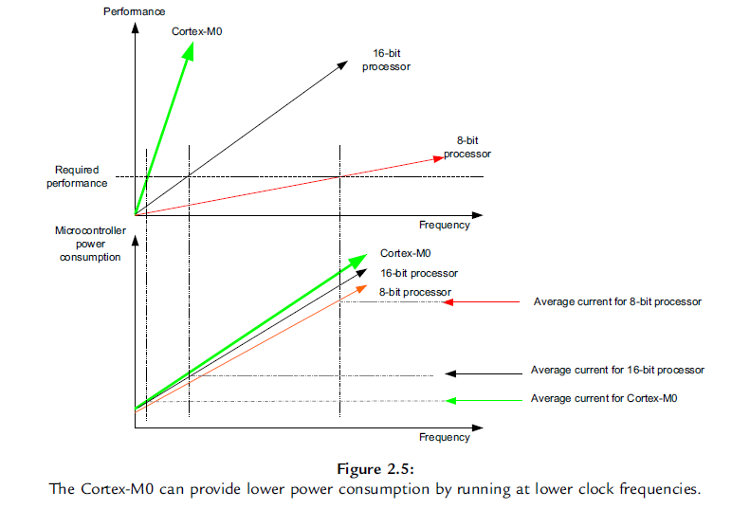
Performance and Power Consumption V/s frequency Plot

Slide 24
Easy to Use, Software Portability
All the software code for the ARM Cortex microcontrollers can be written in C, allowing shorter software development time as well as improving software portability

Slide 25
Low-Power Applications
Small gate count
High efficiency
Low-power features (sleep modes)
Logic cell enhancement

Slide 26
Small gate count
The Cortex-M0 processor’s small gate count characteristic directly reduces the active current and leakage current of the processor.
During the development of the Cortex-M0 processor, various design techniques and optimizations were used to make the circuit size as small as possible.
Each part of the design was carefully developed and reviewed to ensure that the circuit size is small (it is a bit likewriting an application program in assembly to achieve the best optimization).
This allows the gate count to be 12k gates at minimum conﬁguration.
Typically, the gate count could be 17k to 25k gates when including more features.
This is about the same size or smaller than typical 16-bit microprocessors, with more than double the system performance.

Slide 27
High efficiency
By having a highly efﬁcient architecture, embedded system designers can develop their product so that it has a lower clock frequency while still being able to provide the required performance, reducing the active current of the product.
With a performance of 0.9DMIPS/ MHz, despite not being very high compared with some modern 32-bit processors, the Dhrystone benchmark result of Cortex-M0 is still higher than the older generation of 32-bit desktop processors like the 80486DX2 (0.81DMIPS/MHz), and it is a lot smaller.
The high efﬁciency of the Cortex-M0 processor is mostly due to the efﬁciency of the Thumb instruction set, as well as highly optimized hardware implementation.

Slide 28
Low-Power Features
The Cortex-M0 processors have a number of low-power features that allow embedded product developers to reduce the product’s power consumption.
First, the processor provides two sleep modes and they can be entered easily with “Wait-for-Interrupt” (WFI) or “Wait- for-Event” (WFE) instructions.
The power management unit on the chip can use the sleep status of the processor to reduce the power consumption of the system.
The Cortex-M0 processor also provides a “Sleep-on-Exit” feature, which causes the processor to run only when an interrupt service is required.
In addition, the Cortex-M0 processor has been carefully developed so that some parts of the processor, like the debug system, can be switched off when not required.

Slide 29
Apart from these normal sleep features, the Cortex-M0 processor also supports a unique feature called the Wakeup Interrupt Controller(WIC).
This allows the processor to be powered down while still allowing interrupt events to power up the system and resume operation almost instantaneously when required. This greatly reduces the leakage current (static power consumption) of the system during sleep.

Slide 30
Logic Cell Enhancement
In recent years, there have been enhancements in logic cell designs. Apart from pushing logic gate designs to smaller transistor sizes, the Physical IP (intellectual property) division in ARM has also been working hard to ﬁnd innovative ways to reduce power consumption in embedded systems.
One of the major developments is the introduction of the Ultra Low Leakage (ULL) logic cell library.
The ﬁrst ULL cell library has been developed with a 0.18um process. Apart from reducing the leakage current, the new cell library also supports special state retention cells that can hold state information while the rest of the system is powered down.
ARM also works with leading EDA tools vendors to allow chip vendors to make use of these new technologies in their chip designs.

Slide 31
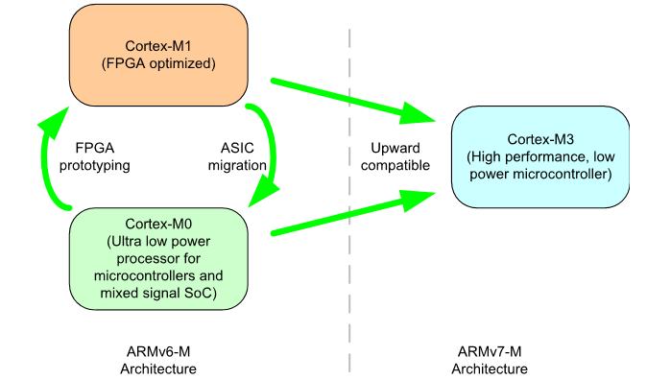
Cortex-M0 Software Portability

Slide 32
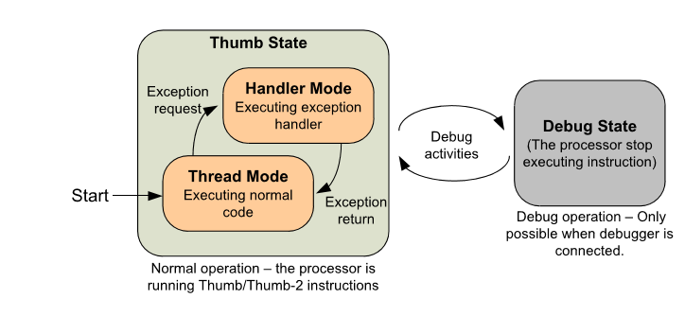
PROGRAMMERS MODEL

Slide 33
The Cortex-M0 processor has two operation modes and two states.
When the processor is running a program, it is in the Thumb state. In this state, it can be either in the Thread mode or the Handler mode.

Slide 34
Registers and Special Registers
To perform data processing and controls, a number of registers are required inside the processor core.
If data from memory are to be processed, they have to be loaded from the memory to a register in the register bank, processed inside the processor, and then written back to the memory if needed.
This is commonly called a “load-store architecture.” By having a sufﬁcient number of registers in the register bank, this mechanism is easy to use and is C friendly.
It is easy for C compilers to compile a C program into machine code with good performance. By using internal registers for short-term data storage, the amount of memory accesses can be reduced.
The Cortex-M0 processor provides a register bank of 13 general-purpose 32-bit registers and a number of special registers

Slide 35
Continueed..
R0-R12 Registers R0 to R12 are for general uses.
Because of the limited space in the 16-bit Thumb instructions, many of the Thumb instructions can only access R0 to R7, which are also called the low registers, whereas some instructions, like MOV (move), can be used on all registers.
When using these registers with ARM development tools such as the ARM assembler, you can use either uppercase (e.g., R0) or lowercase (e.g., r0) to specify the register to be used.
The initial values of R0 to R12 at reset are undeﬁned.
R13, Stack Pointer (SP) R13 is the stack pointer. It is used for accessing the stack memory via PUSH and POP operations.
There are physically two different stack pointers in Cortex-M0.
The main stack. pointer (MSP, or SP_main in ARM documentation) is the default stack pointer after reset, and it is used when running exception handlers.
The process stack pointer (PSP, or SP_process in ARM documentation) can only be used in Thread mode (when not handling exceptions).
The stack pointer selection is determined by the CONTROL register, one of the special registers that will be introduced later.

Slide 36
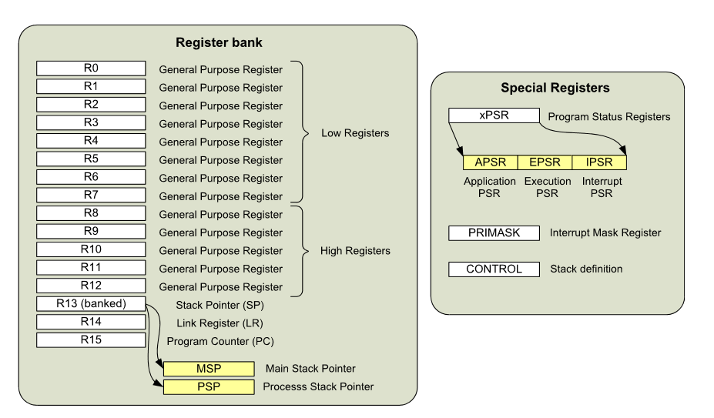
Register Banks and Special Registers

Slide 37
Stack Pointer
R13, Stack Pointer (SP) R13 is the stack pointer. It is used for accessing the stack memory via PUSH and POP operations. There are physically two different stack pointers in Cortex-M0.
The main stack pointer (MSP, or SP_main in ARM documentation) is the default stack pointer after reset, and it is used when running exception handlers.
The process stack pointer (PSP, or SP_process in ARM documentation) can only be used in Thread mode (when not handling exceptions).
The stack pointer selection is determined by the CONTROL register, one of the special registers that will be introduced later. When using ARM development tools, you can access the stack pointer using either “R13” or “SP.” Both uppercase and lowercase (e.g., “r13” or “sp”) can be used.

Slide 38
Only one of the stack pointers is visible at a given time. However, you can access to the MSP or PSP directly when using the special register access instructions MRS and MSR.
In such cases, the register names “MSP” or “PSP” should be used.
The lowest two bits of the stack pointers are always zero, and writes to these two bits are ignored.
In ARM processors, PUSH and POP are always 32-bit accesses because the registers are 32-bit, and the transfers in stack operations must be aligned to a 32-bit word boundary.
The initial value of MSP is loaded from the ﬁrst 32-bit word of the vector table from the program memory during the startup sequence.
The initial value of PSP is undeﬁned. It is not necessary to use the PSP. In many applications, the system can completely rely on the MSP.
The PSP is normally used in designs with an OS, where the stack memory for OS Kernel and the thread level application code must be separated.

Slide 39
R14-Link Register
R14, Link Register (LR) R14 is the Link Register.
The Link Register is used for storing the return address of a subroutine or function call.
At the end of the subroutine or function, the return address stored in LR is loaded into the program counter so that the execution of the calling program can be resumed.
In the case where an exception occurs, the LR also provides a special code value, which is used by the exception return mechanism.
When using ARM development tools, you can access to the Link Register using either “R14” or “LR.”

Slide 40
Both upper and lowercase (e.g., “r14” or “lr”) can be used.
Although the return address in the Cortex-M0 processor is always an even address (bit[0] is zero because the smallest instructions are 16-bit and must be half-word aligned), bit zero of LR is readable and writeable.
In the ARMv6-M architecture, some instructions require bit zero of a function address set to 1 to indicate Thumb state.

Slide 41
R15-Program Counter
R15, Program Counter (PC) R15 is the Program Counter. It is readable and writeable. A read returns the current instruction address plus four (this is caused by the pipeline nature of the design).
Writing to R15 will cause a branch to take place (but unlike a function call, the Link Register does not get updated).
In the ARM assembler, you can access the Program Counter, using either “R15” or “PC,” in either upper or lower case (e.g., “r15” or “pc”). Instruction addresses in theCortex-M0 processor must be aligned to half-word address,which means the actual bit zero of the PC should be zero all the time.
However, when attempting to carry out a branch using the branch instructions (BX 2 or BLX), the LSB of the PC should be set to 1. This is to indicate that the branch target is a Thumb program region. Otherwise, it can imply trying to switch the processor to ARM state (depending on the instruction used), which is not supported and will cause a fault exception.

Slide 42
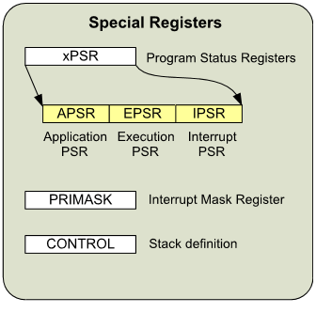
xPSR
xPSR, combined Program Status Register The combined Program Status Register provides information about program execution and the ALU ﬂags.
It is consists of the following three Program Status Registers (PSRs)
Application PSR (APSR)
Interrupt PSR (IPSR)
Execution PSR (EPSR)

Slide 43
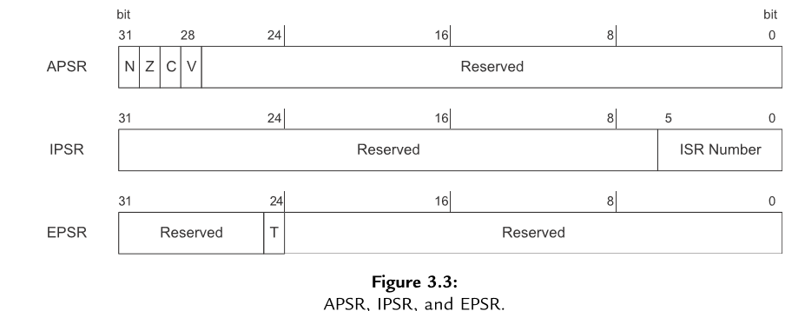
APSR,IPSR and EPSR
The APSR contains the ALU ﬂags: N (negative ﬂag), Z (zero ﬂag), C (carry or borrow ﬂag), and V (overﬂow ﬂag). These bits are at the top 4 bits of the APSR. The common use of these ﬂags is to control conditional branches.

Slide 44
The APSR contains the ALU ﬂags: N (negative ﬂag), Z (zero ﬂag), C (carry or borrow ﬂag), and V (overﬂow ﬂag). These bits are at the top 4 bits of the APSR. The common use of these ﬂags is to control conditional branches.
The IPSR contains the current executing interrupt service routine (ISR) number. Each exception on the Cortex-M0 processor has a unique associated ISR number (exception type).
This is useful for identifying the current interrupt type during debugging and allows an exception handler that is shared by several exceptions to know what exception it is serving.
The EPSR on the Cortex-M0 processor contains the T-bit, which indicates that the processor is in the Thumb state.
On the Cortex-M0 processor, this bit is normally set to 1 because the Cortex-M0 only supports the Thumb state.

Slide 45
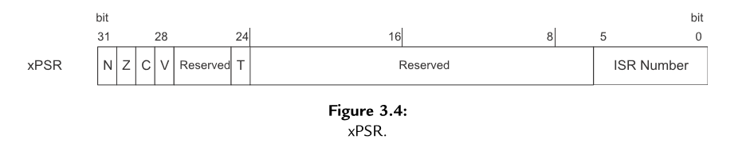
If this bit is cleared, a hard fault exception will be generated in the next instruction execution. These three registers can be accessed as one register called xPSR (Figure 3.4).
For example, when an interrupt takes place, the xPSR is one of the registers that is stored onto the stack memory automatically and is restored automatically after returning from an exception.
During the stack store and restore, the xPSR is treated as one register.

Slide 46
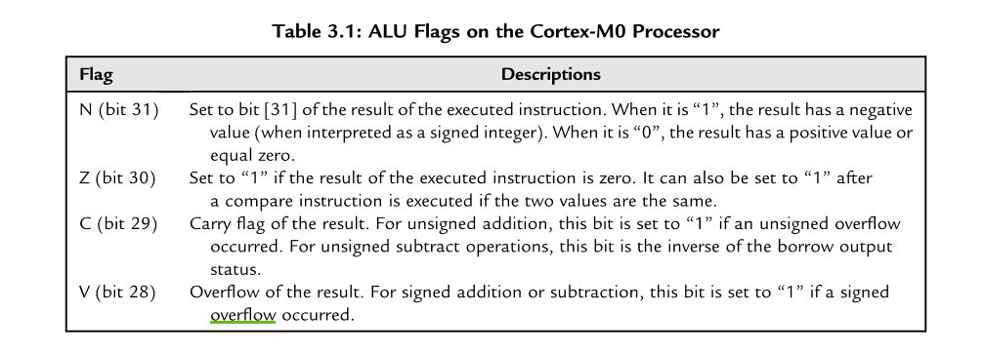
Behaviors of the Application Program Status Register (APSR)

Slide 47
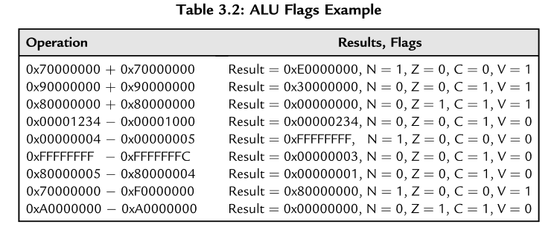
Example
The other common usage of APSR ﬂag is to control branching.
The other common usage of APSR ﬂag is to control branching.

Slide 48
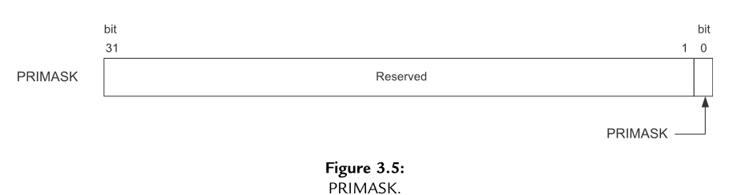
PRIMASK
PRIMASK: Interrupt Mask Special Register The PRIMASK register is a 1-bit-wide interrupt mask register (Figure 3.5).
When set, it blocks all interrupts apart from the nonmaskable interrupt (NMI) and the hard fault exception.
Effectively it raises the current interrupt priority level to 0, which is the highest value for a programmable exception.
ThePRIMASK register can be accessed using special register access instructions(MSR,MRS) as well as using an instruction called the Change Processor State (CPS).
This is commonly used for handling time-critical routines.

Slide 49
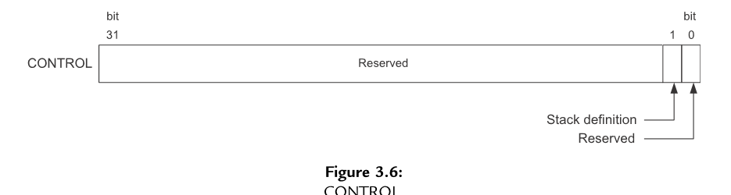
Control Register
CONTROL: Special Register As mentioned earlier, there are two stack pointers in the Cortex-M0 processor.
The stack pointer selection is determined by the processor mode as well as the conﬁguration of the CONTROL register (Figure 3.6).
After reset, the main stack pointer (MSP) is used, but can be switched to the process stack pointer (PSP) in Thread mode (when not running an exception handler) by setting bit [1] in the CONTROL register (Figure 3.7).

Slide 50
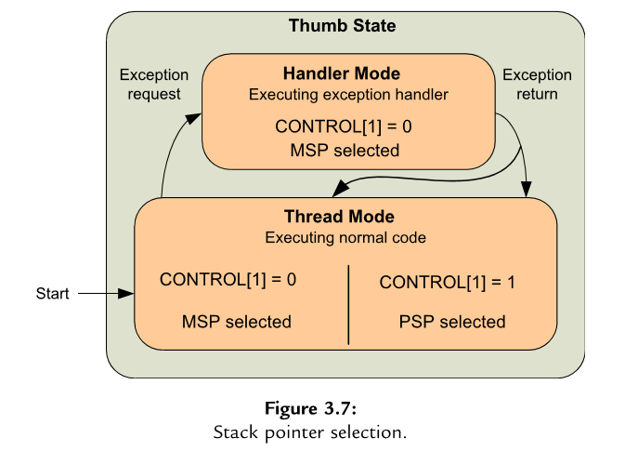
Setting of CONTROL

Slide 51
CONTROL REGISTERS
During running of an exception handler (when the processor is in Handler mode), only the MSP is used, and the CONTROL register reads as zero.
The CONTROL register can only be changed in Thread mode or via the exception entrance and return mechanism. Bit 0 of the CONTROL register is reserved to maintain compatibility with the Cortex-M3 processor.
In the Cortex-M3 processor, bit 0 can be used to switch the processor to User mode (non-privileged mode). This feature is not available in the Cortex-M0 processor.

Slide 52
Memory System Overview
The Cortex-M0 processor has 4 GB of memory address space (Figure 3.8).
The memory space is architecturally deﬁned as a number of regions, with each region having a recommended usage to help software porting between different devices.
The Cortex-M0 processor contains a number of built-in components like the NVIC and a number of debug components.
These are in ﬁxed memory locations within the system region of the memory map. As a result, all the devices based on the Cortex-M0 have the same programming model for interrupt control and debug.
This makes it convenient for software porting and helps debug tool vendors to develop debug solutions for the Cortex-M0 based microcontroller or system-on-chip (SoC) products.

Slide 53
In most cases, the memories connected to the Cortex-M0 are 32-bits, but it is also possible to connect memory of different data widths to the Cortex-M0 processor with suitable memory interface hardware.
The Cortex-M0 memory system supports memory transfers of different sizes such as byte (8-bit), half word (16-bit), and word (32-bit). The Cortex-M0

Slide 54
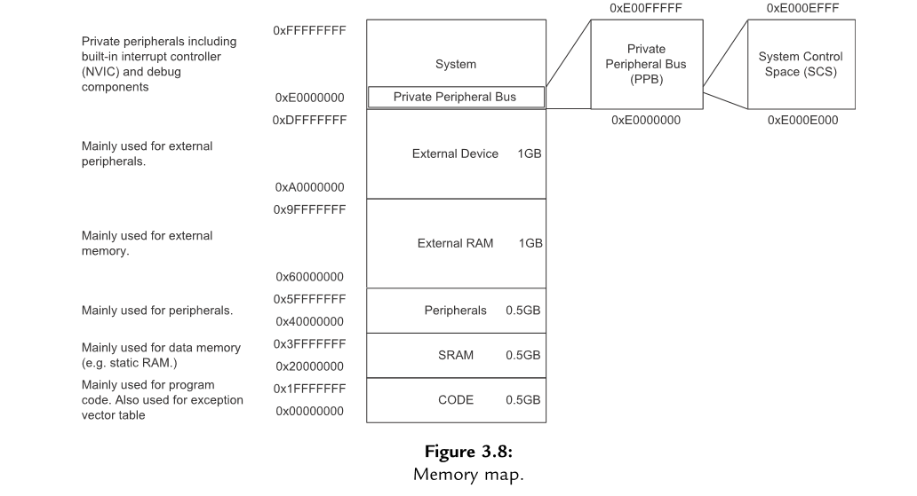
Memory Overview

Slide 55
Stack Memory Operations
Stack memory is a memory usage mechanism that allows the system memory to be used as temporary data storage that behaves as a ﬁrst-in, last-out buffer.
One of the essential elements of stack memory operation is a register called the stack pointer. The stack pointer is adjusted automatically each time a stack operation is carried out.
In the Cortex-M0 processor, the stack pointer is register R13 in the register bank. Physically there are two stack pointers in the Cortex-M0 processor, but only one of them is used at one time, depending on the current value of the CONTROL register and the state of the processor (see Figure 3.7).
In common terms, storing data to the stack is called pushing (using the PUSH instruction) and restoring data from the stack is called popping (using the POP instruction).
the

Slide 56
Depending on processor architecture, some processors perform storing of new data to stack memory using incremental address indexing and some use decrement address indexing.
In the Cortex-M0 processor, the stack operation is based on a “full-descending” stack model. This means

Slide 57
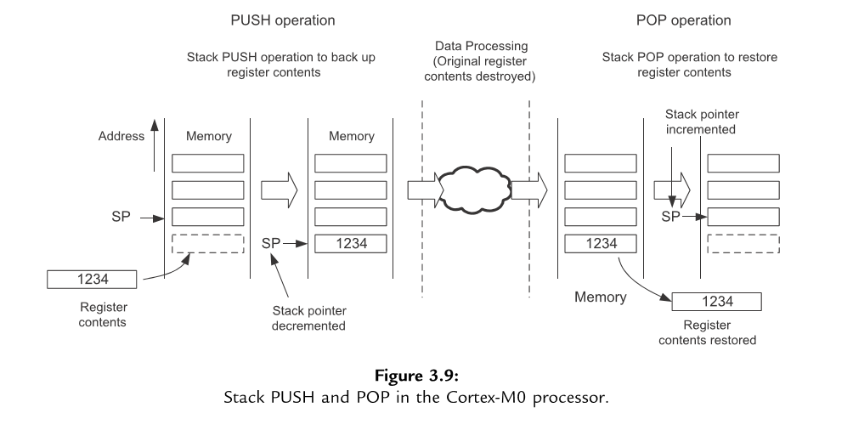
PUSH POP OPERATION

Slide 58
Continueed…
stack pointer always points to the last ﬁlled data in the stack memory, and the stack pointer predecrements for each new data store (PUSH) (Figure 3.9).
PUSH and POP are commonly used at the beginning and end of a function or subroutine. At the beginning of a function, the current contents of the registers used by the calling program are stored onto the stack memory using a PUSH operation, and at the end of the function, the data on the stack memory is restored to the registers using a POP operation.
Typically, each register PUSH operation should have a corresponding register POP operation, otherwise the stack pointer will not be able to restore registers to their original values.
This can result in unpredictable behavior, for example, stack overﬂow. The minimum data size to be transferred for each push and pop operations is one word (32-bit), and multiple registers can be pushed or popped in one instruction.

Slide 59
Continueed..
The stack memory accesses in the Cortex-M0 processor are designed to be always word aligned (address values must be a multiple of 4, for example, 0x0, 0x4, 0x8, etc.), as this gives the best efﬁciency for minimum design complexity.
For this reason, bits [1:0] of both stack pointers in the Cortex-M0 processor are hardwired to zeros and read as zeros. The stack pointer can be accessed as either R13 or SP. Depending on the processor state and the CONTROL register value, the stack pointer accessed can either be the main stack pointer (MSP) or the process stack pointer (PSP).
In many simple applications, only one stack pointer is needed and by default the main stack pointer (MSP) is used. The process stack pointer (PSP) is usually only required when an operating system (OS) is used in the embedded application (Table 3.3).

Slide 60
SP with PUSH and POPInstructions
__main
LDR r3,=0x20000100
LDR r0,=0x20000050
LDMIA r3!,{r1,r2}
mov SP,r0
PUSH {r1,r2}
POP {r4,r5}
stop B stop
END ; End of file

Slide 61
Exceptions and Interrupts
Exceptions are events that cause change to program control: instead of continuing program execution, the processor suspends the current executing task and executes a part of the programcode called the exception handler.
After the exception handler is completed, it will then resume the normal program execution.
There are various types of exceptions, and interrupts are a subset of exceptions.
The Cortex-M0 processor supports up to 32 external interrupts (commonly referred as IRQs) and an additional special interrupt called the nonmaskable interrupt (NMI).

Slide 62
The exception handlers for interrupt events are commonly known as interrupt service routines (ISRs).
Interrupts are usually generated by on-chip peripherals, or by external input through I/O ports.
The number of available interrupts on the Cortex-M0 processor depends on the microcontroller product you use.
In systems with more peripherals, it is possible for multiple interrupt sources to share one interrupt connection.

Slide 63
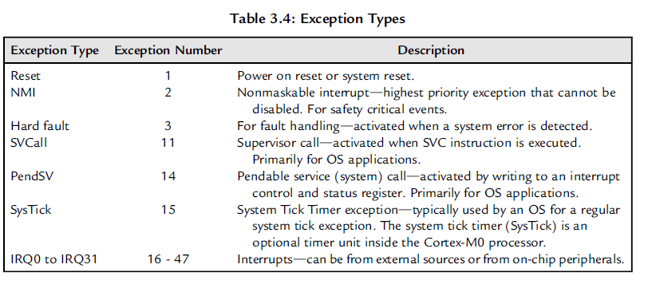
INTERRUPTS AND EXCEPTIONS
Besides the NMI and IRQ, there are a number of system exceptions in the Cortex-M0 processor, primarily for OS use and fault handling (Table 3.4).

Slide 64
INTERRUPTS AND EXCEPTIONS
Each exception has an exception number. This number is reflected in various registers
including the IPSR and is used to define the exception vector addresses. Note that exception
numbers are separated from interrupt numbers used in device driver libraries.

Slide 65
Nested Vectored Interrupt Controller (NVIC)
To prioritize the interrupt requests and handle other exceptions, the Cortex-M0 processor hasa built-in interrupt controller called the Nested Vectored Interrupt Controller (NVIC).
The interrupt management function is controlled by a number of programmable registers in the NVIC.

Slide 66
These registers are memory mapped, with the addresses located within the System Control Space (SCS) as illustrated in Figure 3.8.

Slide 67
The NVIC supports a number of features
• Flexible interrupt management
• Nested interrupt support
• Vectored exception entry
• Interrupt masking

Slide 68
Flexible Interrupt Management
In the Cortex-M0 processor, each external interrupt can be enabled or disabled and can have its pending status set or clear by software.
It can also a signal level (interrupt request froma peripheral remain asserted until the interrupt service routine clears the interrupt request), as well as an exception request pulse (minimum1 clock cycle).

Slide 69
This allows the interrupt controller to be used with any interrupt source.

Slide 70
Nested Interrupt Support
In the Cortex-M0 processor, each exception has a priority level. The priority level can
be fixed or programmable. When an exception occurs, such as an external interrupt, the

Slide 71
NVIC will compare the priority of this exception to the current level.
If the new exception has a higher priority, the current running task will be suspended.
Some of the registers will be stored on to the stack memory, and the processor will start executing the exception handler of the new exception.

Slide 72
This process is called “preemption.” When the higher priority exception handler is complete, it is terminated with an exception return operation and the processor automatically restores the registers from the stack and resumes the task that was running previously.
This mechanism allows nesting of exception services without any software overhead.

Slide 73
Vectored Exception Entry
When an exception occurs, the processor will need to locate the starting point of thecorresponding exception handler.
Traditionally, in ARM processors such as the ARM7TDMI, software usually handles this step.
The Cortex-M0 automatically locates the starting point of the exception handler from a vector table in the memory.

Slide 74
As a result, the delay from the start of the exception to the execution of the exception handlers is reduced.

Slide 75
Interrupt Masking
The NVIC in the Cortex-M0 processor provides an interrupt masking feature via the
PRIMASK special register. This can disable all exceptions except hard fault and
NMI.

Slide 76
Program Image and Startup Sequence
To understand the startup sequence of the Cortex-M0 processor, we need to have a quick overview on the program image first.
Normally, the program image for the Cortex-M0processor is located from address 0x00000000.

Slide 77
The beginning of the program image contains the vector table (Figure 3.11).
It contains the starting addresses (vectors) of exceptions.
Each vector is located in address of “Exception_Number 4.” For example, external IRQ #0 is exception type #16, therefore the address of the vector for IRQ#0 is in 16 4 ¼ 040.

Slide 78
These vectors have LSB set to 1 to indicate that the exceptions handlers are to be executed with Thumb instructions.
The size of the vector table depends on how many interrupts are implemented.

Slide 79
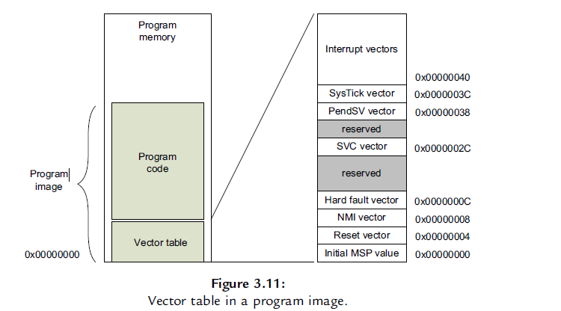

Slide 80
The vector table also defines the initial value of the main stack pointer (MSP). This is stored in the first word of the vector table.
When the processor exits from reset, it will first read the first two-word addresses in the vector table.
The first word is the initial MSP value, and the second word is the reset vector(Figure 3.12), which determines the starting of the program execution address (reset handler). which determines the starting of the program execution address

Slide 81
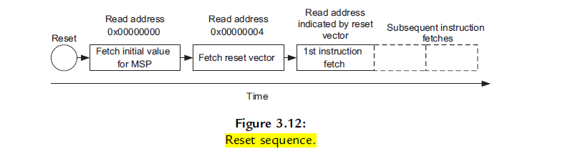
RESET SEQUENCE

Slide 82
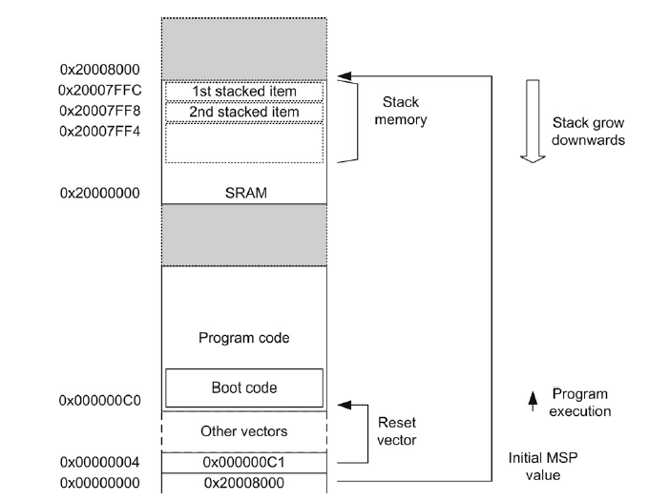
HOW RESETTING and INTIATION OF BOOT CODE STARTS

Slide 83
For example, if we have boot code starting from address 0x000000C0, we need to put this address value in the reset vector location with the LSB set to 1 to indicate that it is Thumb code.
Therefore, the value in address 0x00000004 is set to 0x000000C1 (Figure 3.13).
After the processor fetches the reset vector, it will start executing program code from the address foundthere..

Slide 84
This behavior is different from traditional ARM processors (e.g., ARM7TDMI), where
the processor executes the program starting from address 0x00000000, and the vectors in the vector table are instructions as oppose to address values in the Cortex-M processors

Slide 85
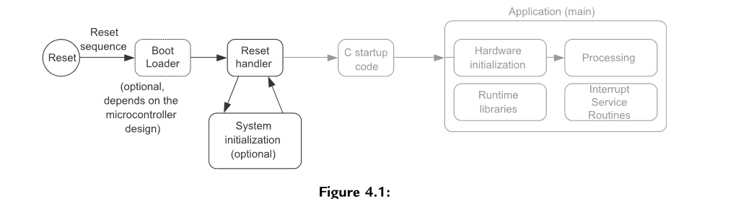

Slide 86
Most modern microcontrollers have on-chip ﬂash memory to hold the compiled program.
The ﬂash memory holds the program in binary machine code format, and therefore programs written in C must be compiled before programmed to the ﬂash memory.
Some of these microcontrollers might also have a separate boot ROM, which contains a small boot loader program that is executed when the microcontroller starts, before executing the user program in the ﬂash memory.
In most cases, only the program code in the ﬂash memory can be changed and the boot loader is ﬁxed. After the ﬂash memory (or other types of program memory) is programmed, the program is then accessible by the processor.
After the processor is reset, it carries out the reset sequence, as outlined at the end of the previous chapter (Figure 4.1).

Slide 88
In the reset sequence, the processor obtains the initial MSP value and reset vector, and then it executes the reset handler.
All of this required information is usually stored in a program ﬁle called startup code.
The reset handler in the startup code might also perform system initialization (e.g., clock control circuitry and Phase Locked Loop [PLL]), although in some cases system initialization is carried out later when the C program “main()” starts. Example startup code can usually be found in the installation of the development suite or from software packages available from the microcontroller vendors.

Slide 89
Continueed..
After the C startup code is executed, the application starts. The application program often contains the following elements: •
Initialization of hardware (e.g., clock, PLL, peripherals)
The processing part of the application
Interrupt service routines

Slide 90
GPIO A PORT
PRESERVE8 ; Indicate the code here preserve
; 8 byte stack alignment
THUMB ; Indicate THUMB code is used
AREA |.text|, CODE, READONLY
EXPORT main
; Start of CODE area
main
ldr r1, =0x50004080
ldr r2, =0x08
ldr r3, =0x01
lsls r4, r3, #30
str r4, [r1]
ldr r4, =0x0f
adds r1, r1,r2
str r4, [r1]
stop b stop
end

Slide 91
Designing Embedded Programs
There are many ways to structure the ﬂow of the application processing. Here we will cover a few fundamental concepts.
Polling
Interrupt Driven
Combination of Polling and Interrupt Driven.
Handling Concurrent Processes.

Slide 92
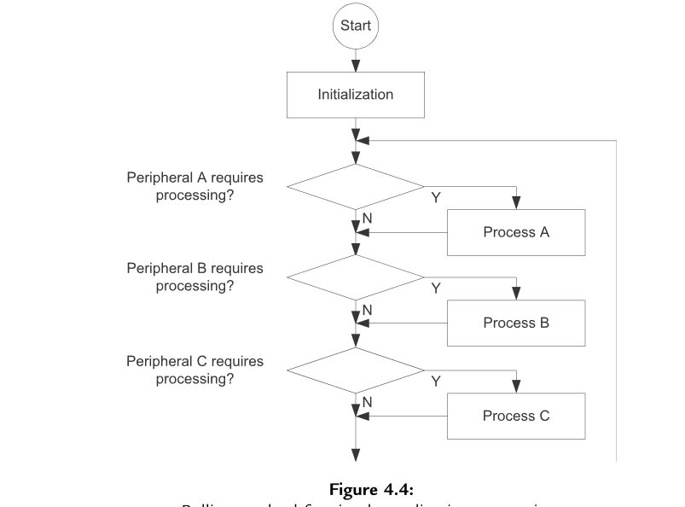
Polling

Slide 93
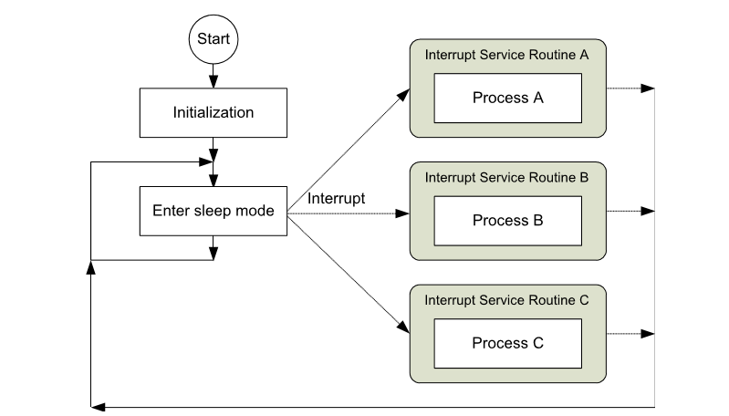
Interrupt Driven

Slide 94
Interrupt Driven
In applications that require lower power, processing can be carried out in interrupt service routines so that the processor can enter sleep mode when no processing is required. Interrupts are usually generated by external sources or on chip peripherals to wake up the processor. In interrupt-driven applications (Figure 4.5),
the interrupts from different devices can be set at different priorities. In this way a high-priority interrupt request can obtain service even when a lower-priority interrupt service is running, which will be temporarily stopped. As a result, the latency for the higher-priority interrupt is reduced.

Slide 95
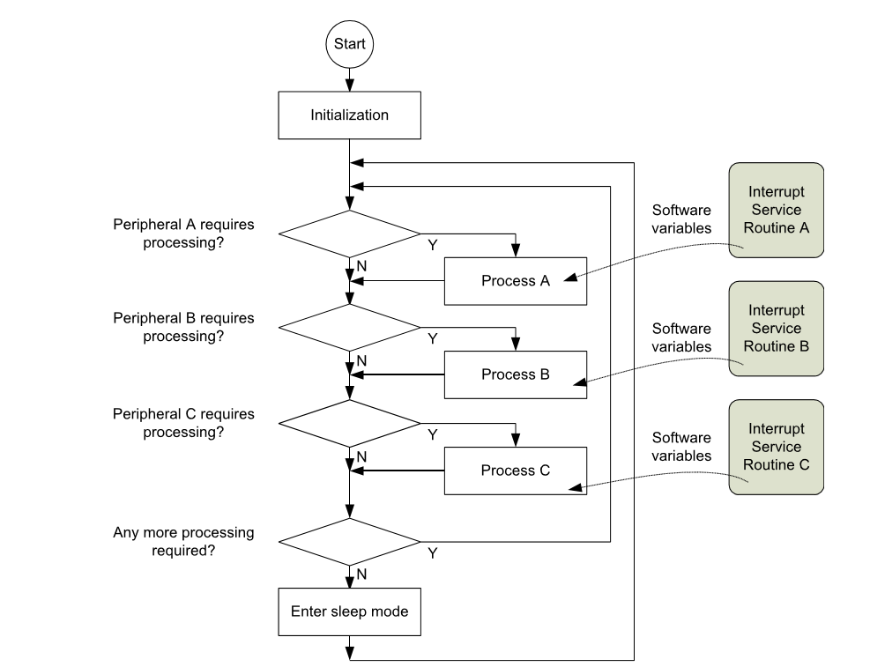
Combination of Interrupt Driven and Polling

Slide 96
Handling Concurrent Processes
In some cases, an application process could take a signiﬁcant amount of time to complete and therefore it is undesirable to handle it in a big loop as shown in Figure 4.6.
If process A takes too long to complete, processes B and C will not able to respond to peripheral requests fast enough, resulting in system failure.
Common solutions are as follows:
1. Breaking down a long processing task to a sequence of states. Each time the process is accessed, only one state is executed.
2. Using a real-time operating system (RTOS) to manage multiple tasks.

Slide 97
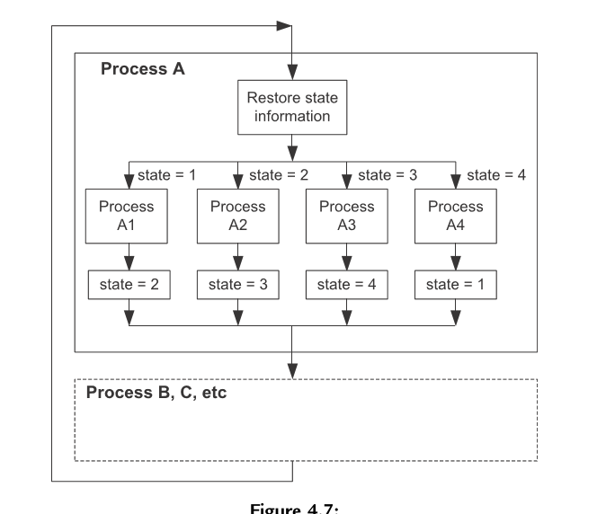
Handling Concurrent Process.

Slide 98
Cortex Microcontroller Software Interface Standard (CMSIS)
Introduction of CMSIS As the complexity of embedded systems increase, the compatibility and reusability of software code becomes more important.
Having reusable software often reduces development time for subsequent projects and hence speeds up time to market, and software compatibility helps the use of third-party software components.
For example, an embedded system project might involve the following software components:
• Software from in-house software developers
• Software reused from other projects
• Device driver libraries from microcontroller vendors
• Embedded OS
• Other third-party software products like a communication protocol stack and codec (compressor/decompressor)
The use of the third-party software components is becoming more and more common. With all these software components being used in one project, compatibility is becoming critical for many large-scale software projects.

Slide 99
To allow a high level of compatibility between these software products and improve software portability, ARM worked with various microcontroller vendors and software solution providers to develop the CMSIS, a common software framework covering most Cortex-M processors and Cortex-M microcontroller products (Figure 4.16).
The CMSIS is implemented as part of device driver library from microcontroller vendors. It provides a standardized software interface to the processor features like NVIC control and system control functions. Many of these processors feature access functions are available in CMSIS for the Cortex-M0, Cortex-M3 and Cortex-M4, allowing easy software porting between these processors.

Slide 100
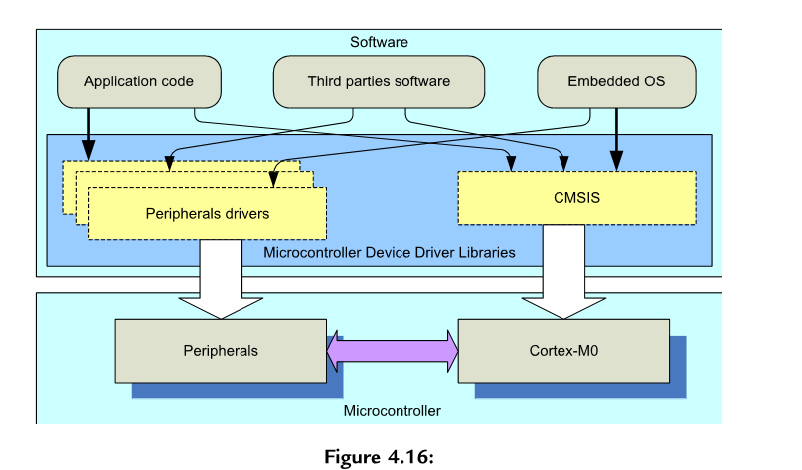

Slide 101
What Is Standardized in CMSIS
The CMSIS standardized the following areas for embedded software:
Standardized access functions for accessing NVIC,
System Control Block (SCB), and System Tick timer (SysTick) such as interrupt control and SysTick initialization.
Standardized register deﬁnitions for NVIC, SCB, and SysTick registers.
For best software portability, we should use the standardized access functions. However, in some cases we need to directly access the registers in NVIC, SCB, or the SysTick.
In such cases, the standardized register deﬁnitions help the software to be more portable.
Standardized functions for accessing special instructions in Cortex-M microcontrollers. Some instructions on the Cortex-M microcontroller cannot be generated by normal C code. If they are needed, they can be generated by these functions provided in CMSIS. Otherwise, users will have to use intrinsic functions provided by the C compiler or embedded/inline assembly language, which are tool chain speciﬁc and less portable.

Slide 102
Standardization
Standardized names for system exceptions handlers. An embedded OS often requires system exceptions. By having standardized system exception handler names, supporting different device driver libraries in an embedded OS is much easier.
Standardized name for the system initialization function. The common system initializa- tion function “void SystemInit(void)” makes it easier for software developers to set up their system with minimum effort.
Standardize variable for clock speed information. A standardized software variable called “SystemFreq” (CMSIS v1.00 to v1.20) or “SystemCoreClock” (CMSIS v1.30 or newer). This is used to determine the processor clock frequency.

Slide 103
CMSIS
The CMSIS also provides the following:
A common platform for device driver libraries each device driver library has the same look and feel, making it easier for beginners to learn and making it easier for software porting.
In future release of CMSIS, it could also provide a set of common communication access functions so that middleware that has been developed can be reused on different devices without porting.

Slide 104
Organization of the CMSIS
The CMSIS is divided into multiple layers:
Core Peripheral Access Layer
-Name deﬁnitions, address deﬁnitions, and helper functions to access core registers and core peripherals like the NVIC, SCB, and SysTick.
Middleware Access Layer (work in progress)
-Common method to access peripherals for typical embedded systems Targeted at communication interfaces including UART, Ethernet, and SPI
-Allows embedded software to be used on any Cortex microcontrollers that support the required communication interface
Device Peripheral Access Layer (MCU speciﬁc)
- Register name deﬁnitions, address deﬁnitions, and device driver code to access peripherals
Access Functions for Peripherals (MCU speciﬁc) - Optional helper functions for peripherals

Slide 105
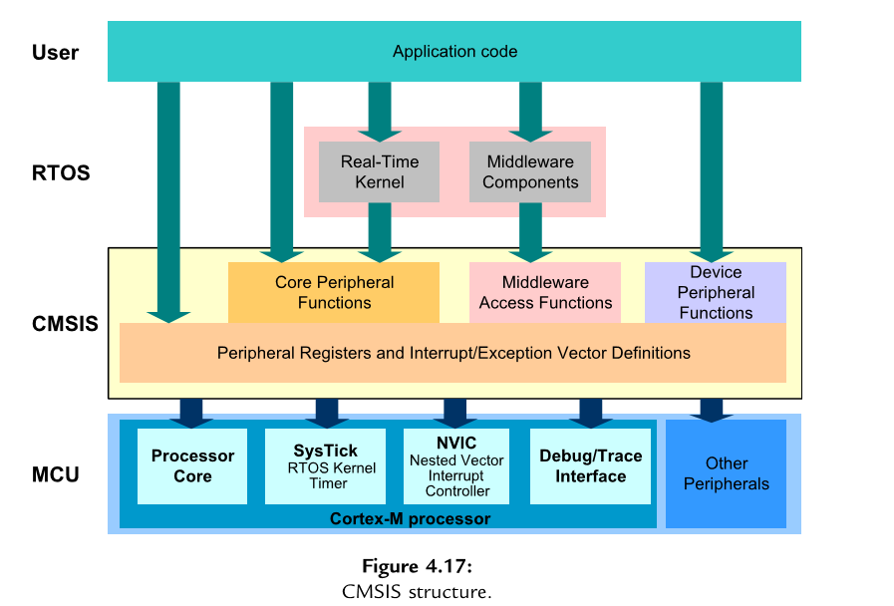
CMSIS Structure

Slide 106
Using CMSIS The CMSIS is an integrated part of the device driver package provided by the microcontroller vendors.
If you are using the device driver libraries for software development, you are already using theCMSIS.
If you are not using device driver libraries from microcontroller vendors, you can still useCMSIS by downloading theCMSIS package from OnARM web site (www.onarm. com), unpacking the ﬁles, and adding the required ﬁles for your project.
For C program code, normally you only need to include one header ﬁle provided in the device driver library from your microcontroller vendor. This header ﬁle then pulls in the all the required header ﬁles for CMSIS features as well as peripheral drivers.

Slide 107
You also need to include the CMSIS-compliant startup code, which can be either in C or assembly code. CMSIS provides various versions of startup code customized for different tool chains.
Figure 4.18 shows a simple project setup using theCMSIS package. The name of some the ﬁles depends on the actual microcontroller device name (indicated as <device> in Figure 4.18). When you use the header ﬁle provided in the device driver library, it automatically includes the other required header ﬁles for you (Table 4.4).

Slide 108
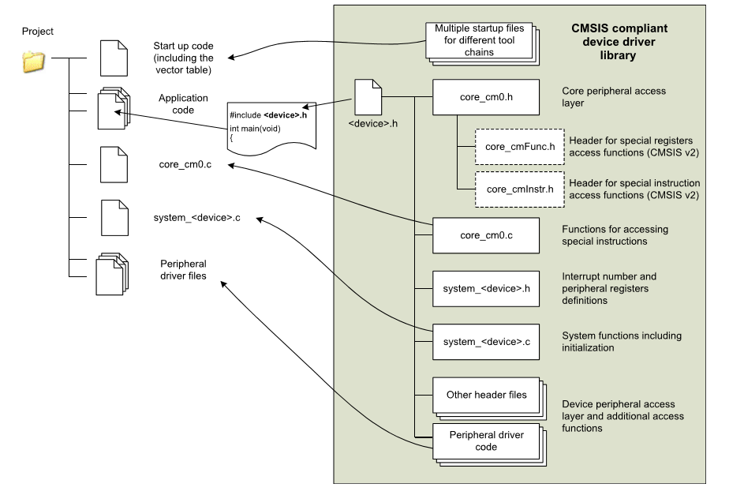
Project

Slide 109
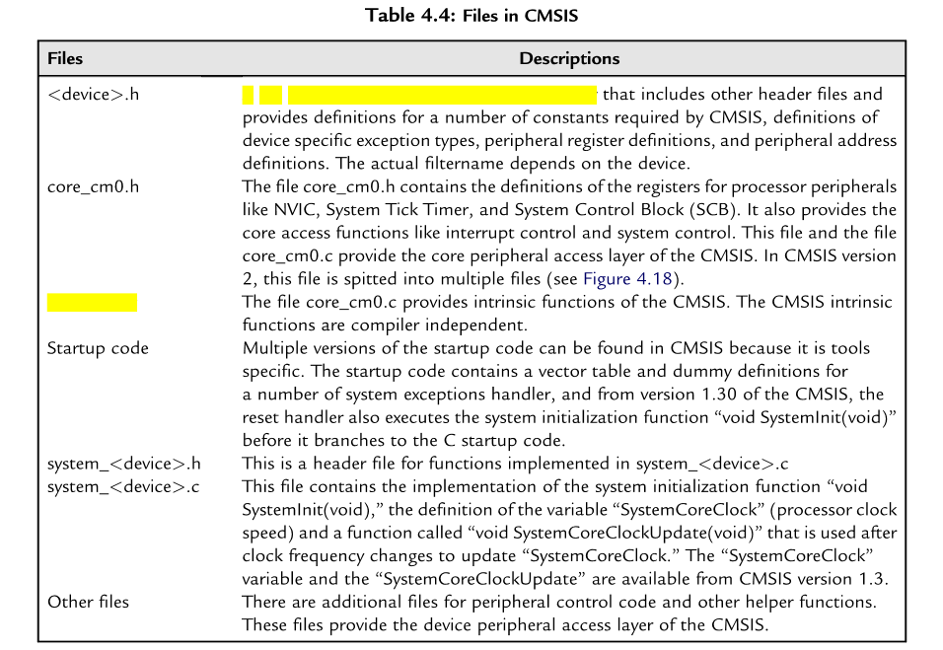
Files in CMSIS
A ﬁle provided by the microcontroller vendor
core_cm0.c

Slide 110
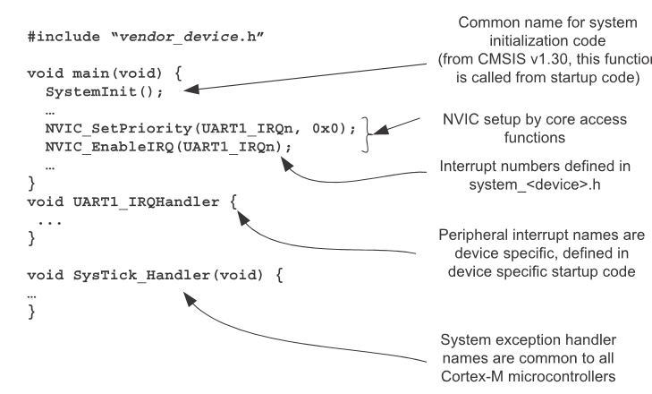
Vendor_device.h

Slide 111
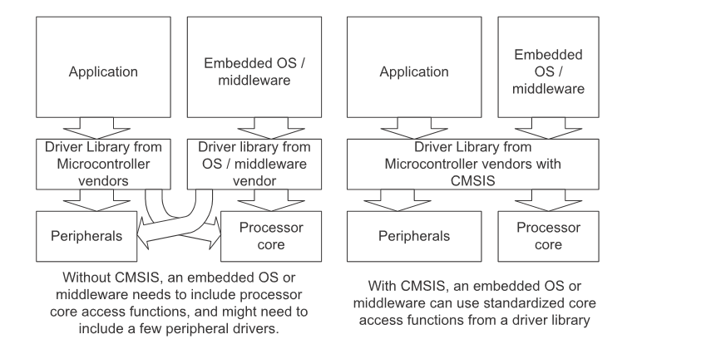
CMSIS avoids overlapping of driver code.

Slide 112
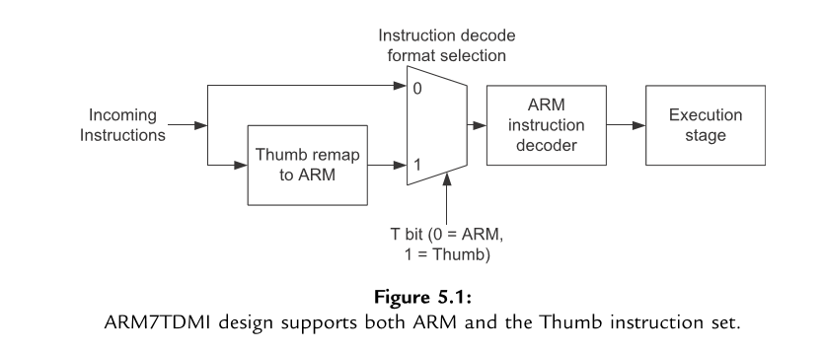
Instruction Set

Slide 113
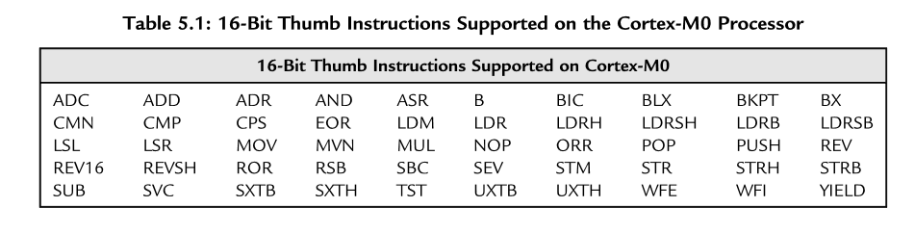
16 Bit Thumb Instructions

Slide 114
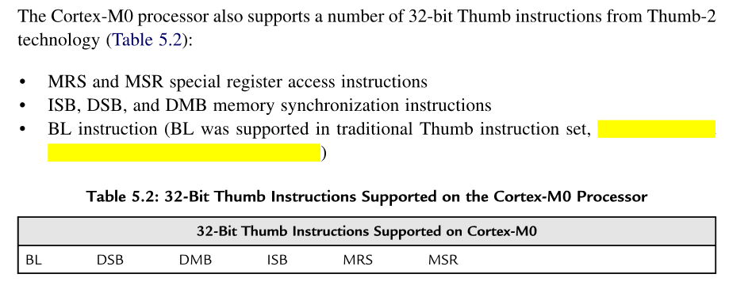
Cortex –M0 processor supports 32-bit Thumb Instructions.
but the bit
ﬁeld deﬁnition was extended in Thumb-2)

Slide 115

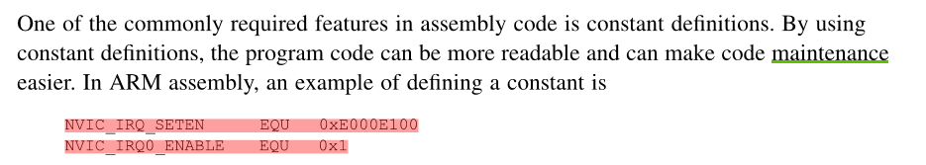

Slide 116
